Slide 1





Global Supermarket Data Analysis

Slide 2


Supervisor: Eng. Ahmed Abd El-Latif
Team Members

Slide 3
Main Points
Introduction to Data Analysis.
Tools For Data Analysis.
Dataset Overview
Project Steps
Data Cleaning & preparation (Using Python)
Exploratory Data Analysis
Reporting Visualization

Slide 4

In today’s world, Data Analysis is crucial for informed decision-making. It helps organizations uncover patterns, trends, and insights from vast amounts of data. By mastering these techniques, businesses can enhance their strategies and drive growth.

Slide 5




Utilizing the right tools like Excel, Tableau, and Python can significantly enhance your data analysis capabilities. These tools provide powerful features for visualization, automation, and collaboration, making the analysis process more efficient and effective.

Slide 6
Dataset Overview
The goal of this project is to analyze the Global Superstore dataset, which consists of four interrelated tables (Orders / Customers/ Products/Returns).
This dataset provides a comprehensive view of sales transactions, return behaviors, and regional demographic information.
The objective of this proposal is to outline a detailed analysis plan to leverage these tables to derive actionable business insights and improve decision-making processes within a condensed timeline of 4 weeks.

Slide 7
Dataset Overview
The dataset consists of 4 tables:
Orders Table
Customers Table
Products Table
Returns Table

Slide 8
Project Steps
Data Cleaning & preparation (Using Python)
Exploratory Data Analysis
Reporting Visualization (Using Tableau)

Slide 9
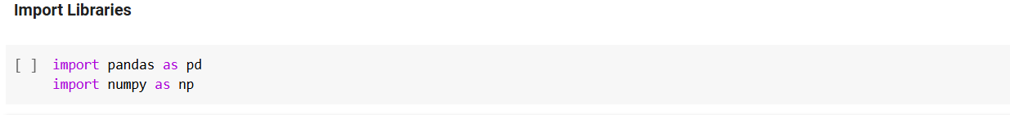
Data Cleaning & preparation (Using Python)
Importing the needed libraries (NumPy, Pandas) to start the process of data cleaning.

Slide 10
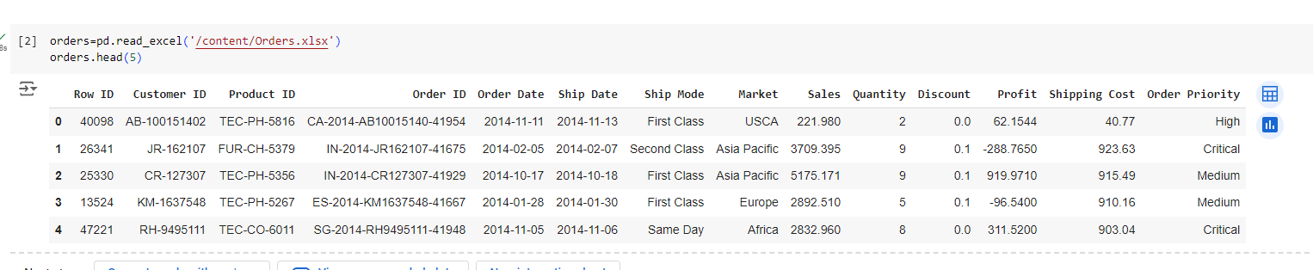
Data Cleaning & preparation (Using Python)
2. Read Orders Dataset:

Slide 11
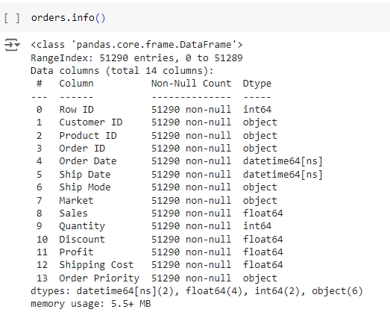
Data Cleaning & preparation (Using Python)
2.1 Understanding Orders Dataset:
Total rows in this dataset is 51290.
Total of 14 columns
There is no nulls in this dataset
Contains 2 Datetime, 4 Floats, 2 Integers and 6 String Datatypes

Slide 12
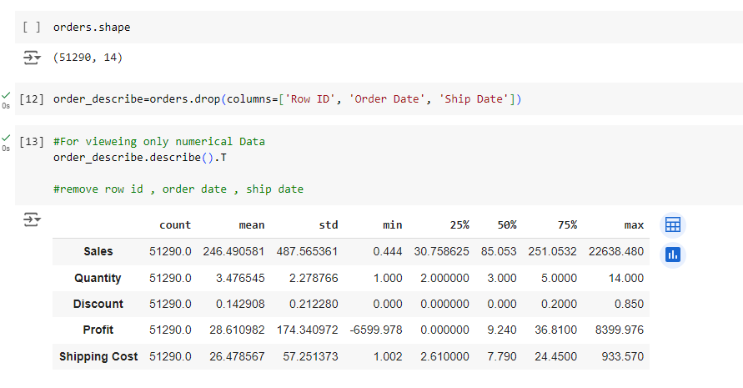
Data Cleaning & preparation (Using Python)
2.2 Understand Orders Dataset:
Dataset is split to get the statistical analysis for the numerical values in it only.

Slide 13
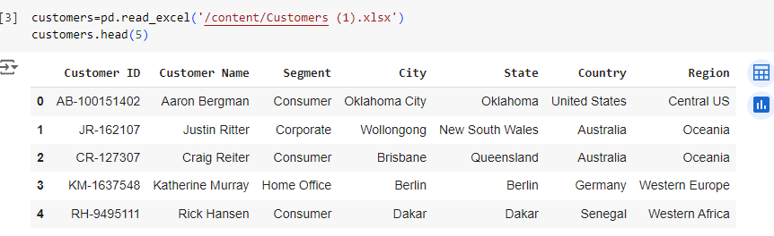
Data Cleaning & preparation (Using Python)
3. Read Customers Dataset:

Slide 14
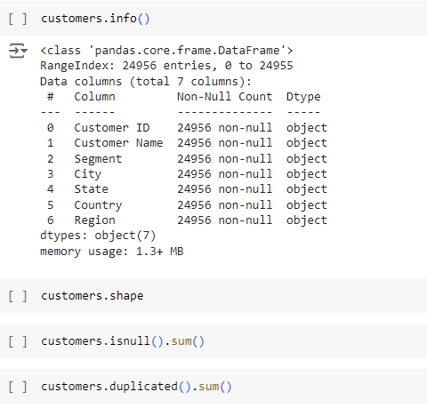
Data Cleaning & preparation (Using Python)
3.1 Understand Customers Dataset
Total rows in this dataset is 24956.
Total 7 columns.
No nulls in this dataset and datatypes doesn’t need to be modified.
Contains 7 String Datatypes.

Slide 15
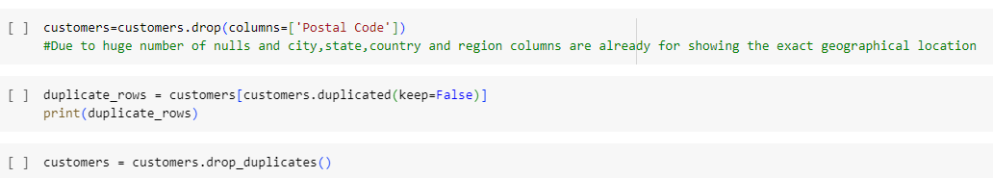
Data Cleaning & preparation (Using Python)
3.2 Clean Customers Dataset
Postal code column is removed because we already have other columns that gives us the exact location.
Duplicated rows are dropped

Slide 16
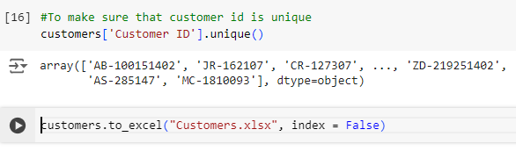
Data Cleaning & preparation (Using Python)
3.3 Check Customers Dataset
Customer ID is a unique column in this dataset
Customers dataset is ready and serves as a fact table

Slide 17
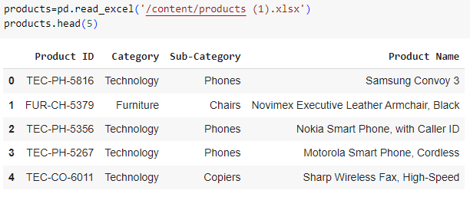
Data Cleaning & preparation (Using Python)
4. Read Product Dataset:

Slide 18
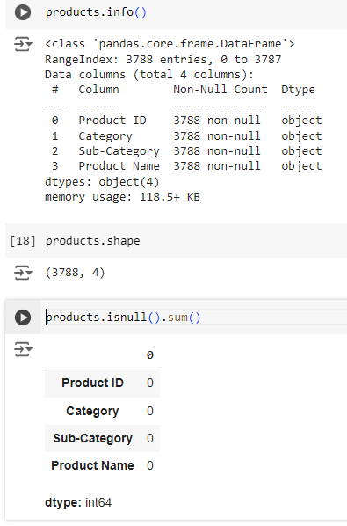
Data Cleaning & preparation (Using Python)
4.1 Understand Products Dataset
Total rows in this dataset is 3788.
Total 4 columns.
No nulls in this dataset and datatypes doesn’t need to be modified.
Contains 4 String Datatypes.

Slide 19
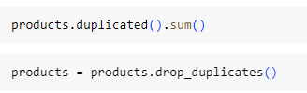
Data Cleaning & preparation (Using Python)
4.2 Clean Customers Dataset
Duplicated rows are dropped
Products dataset is ready and serves as a dim table.

Slide 20
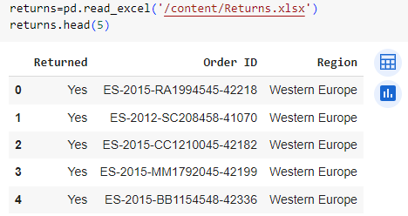
Data Cleaning & preparation (Using Python)
5. Read Returns Dataset:

Slide 21
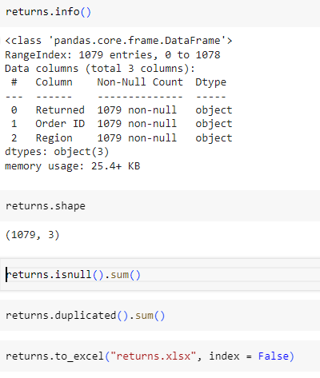
Data Cleaning & preparation (Using Python)
5.1 Understand Customers Dataset
Total rows in this dataset is 1079.
Total 3 columns.
No nulls in this dataset and datatypes doesn’t need to be modified.
Contains 3 String Datatypes.

Slide 22
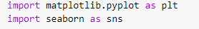
Exploratory Data Analysis
Importing the needed libraries (Matplotlib, Seaborn) to start the process of data cleaning.

Slide 23
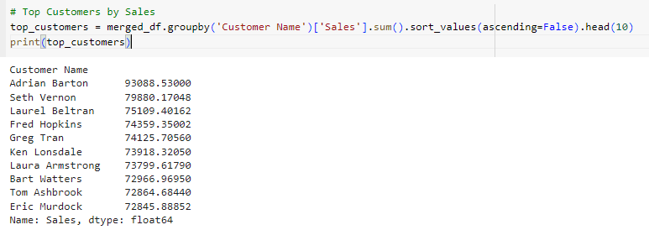
Exploratory Data Analysis
The top 10 customers according to the highest sales achieved are presented in this cell.

Slide 24
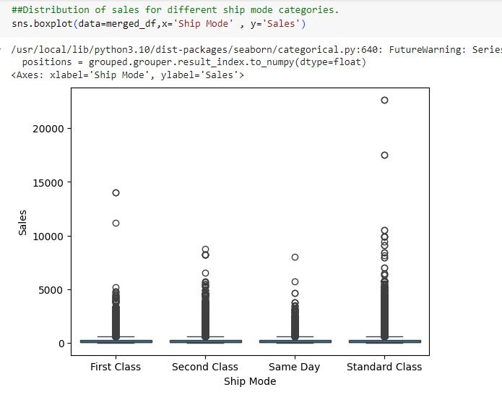
Exploratory Data Analysis
Ship Mode vs. Sales:
Boxplot that shows the distribution of sales for different ship mode categories.
Higher sales in the standard class shipping mode.

Slide 25
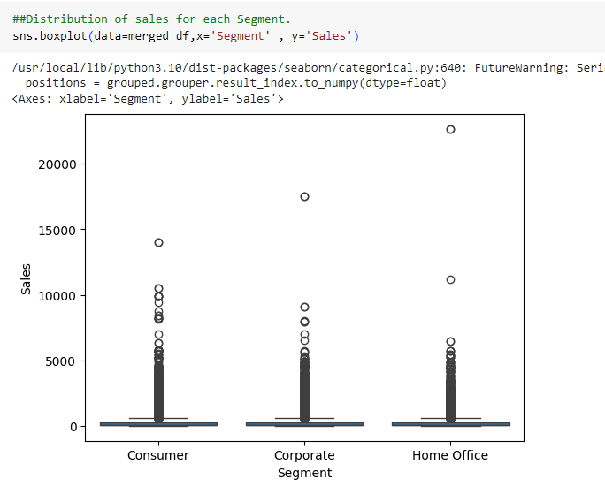
Exploratory Data Analysis
2. Segment vs. Sales:
Boxplot that shows the distribution of sales for each segment.
Higher sales in the consumer segment

Slide 26
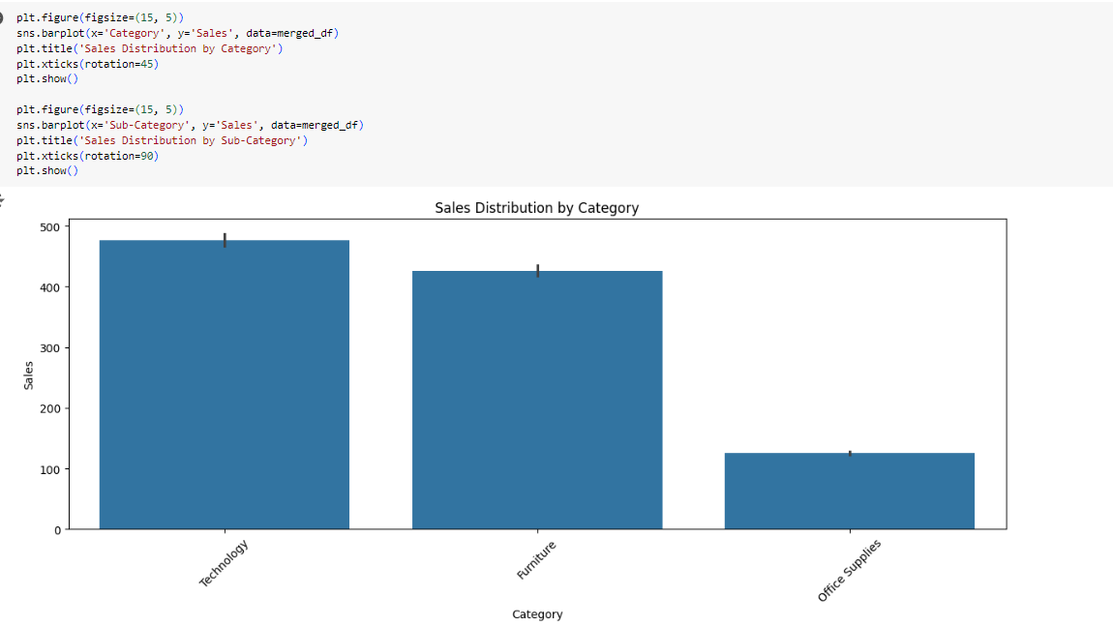
Exploratory Data Analysis
3. Category vs. Sales
This bar plot shows the sales distribution by each category.
Highest sales are achieved in the technology category.

Slide 27
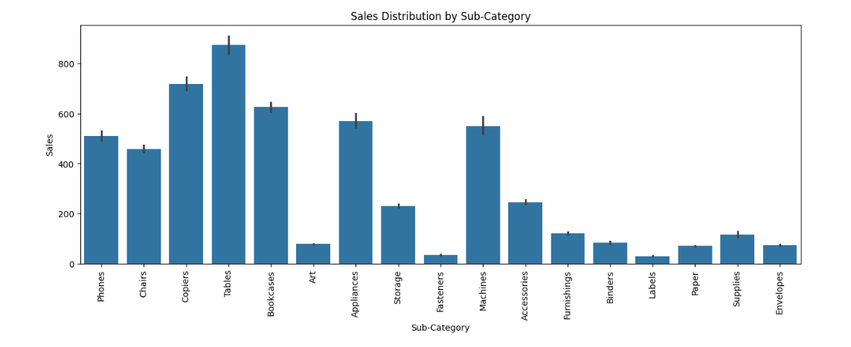
Exploratory Data Analysis
4. Sub-Category vs. Sales
This bar plot shows the sales distribution by each sub-category.
Highest sales are achieved in the tables sub-category.

Slide 28
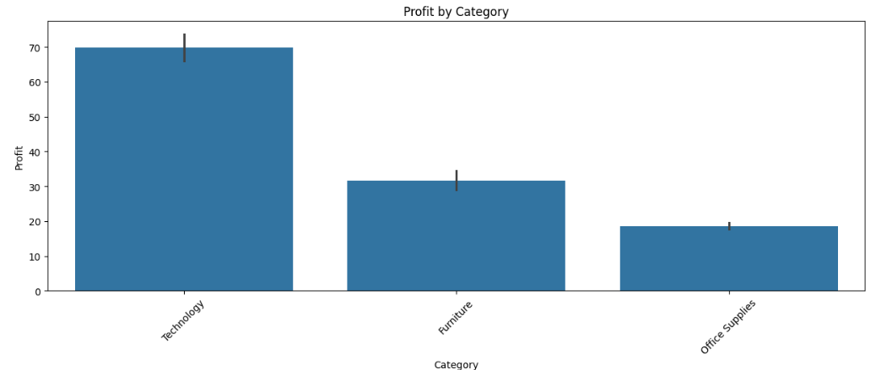
Exploratory Data Analysis
5. Category vs. Profit:
This bar plot shows the Profit distribution by each category.
Highest Profits are achieved in the technology sub-category.

Slide 29
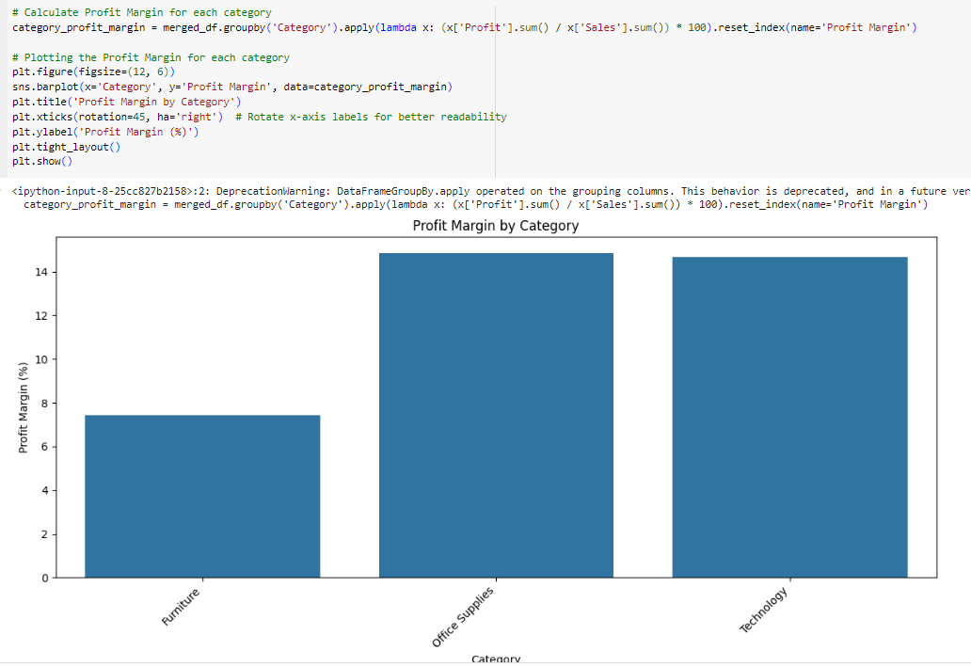
Exploratory Data Analysis
6. Category vs. Profit Margin%:
This bar plot shows the Profit Margin by each category.
Highest Profit Margins are achieved in the office suppliers category.

Slide 30
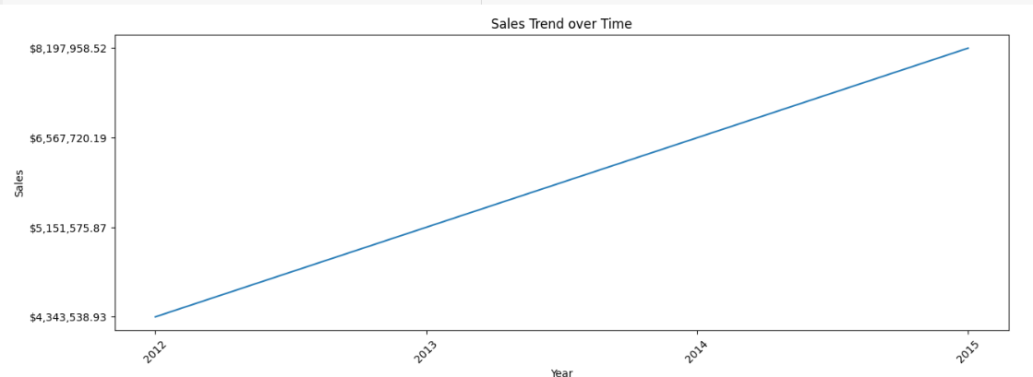
Exploratory Data Analysis
7. Sales Trend Over Time
A plot that shows the yearly sales trends and it shows that the sales are increasing each year.

Slide 31
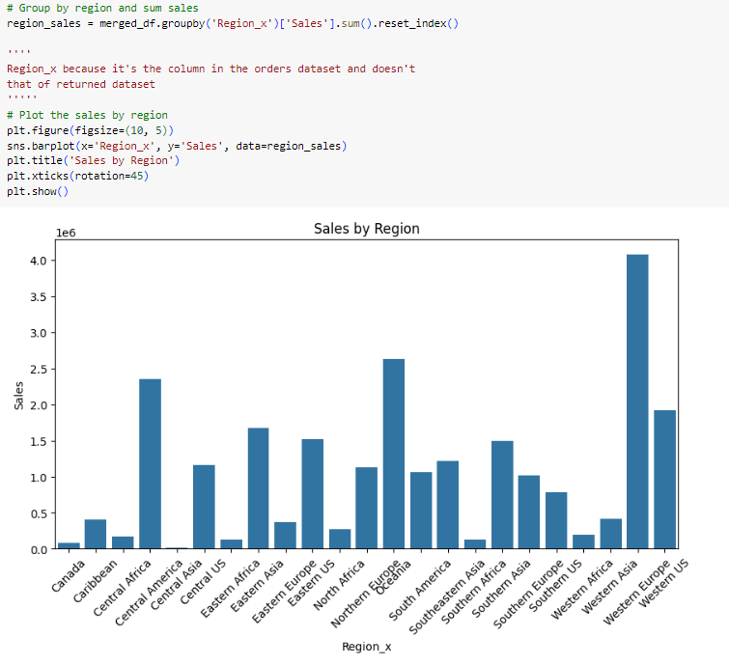
Exploratory Data Analysis
This bar plot shows the Sales by each region.
Highest sales are achieved in Western Europe.

Slide 32
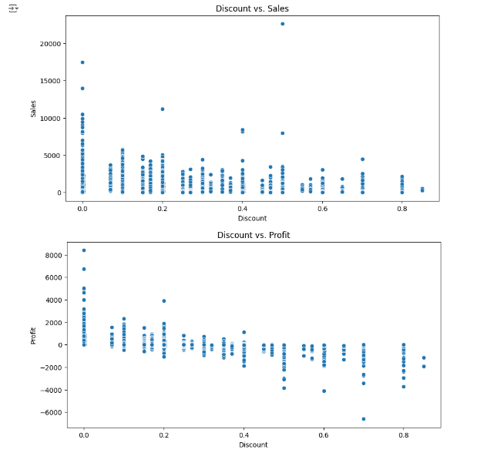
Exploratory Data Analysis
The 1st scatterplot shows the sales vs discount.
As the discount increases the sales decreases.
The 2nd scatterplot shows the profit vs discount
As the discount increases the profit decreases and profit loss occurs.

Slide 33
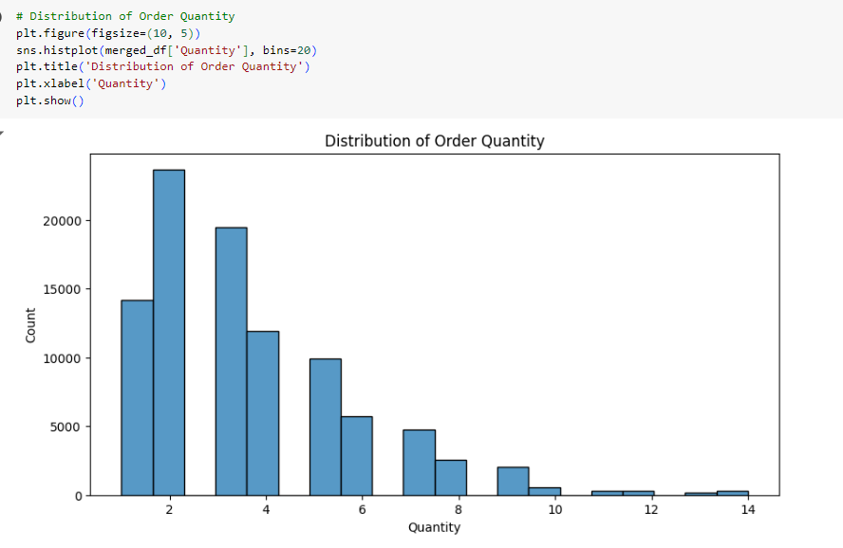
Exploratory Data Analysis
This bar plot shows the frequency of the order’s quantity.

Slide 34
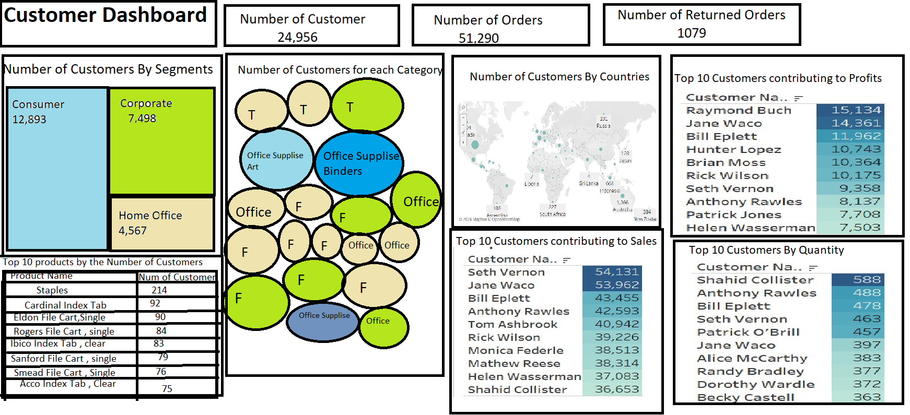
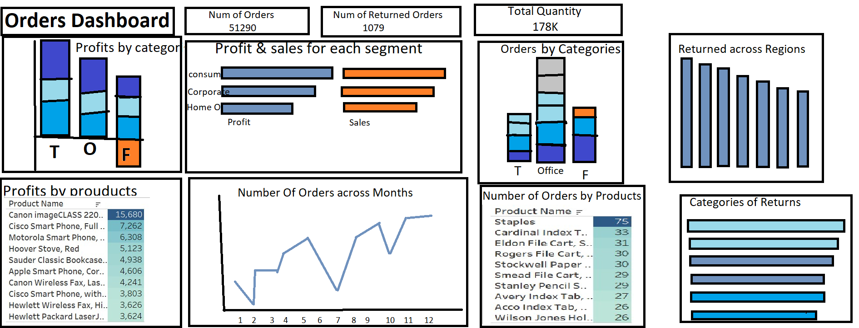
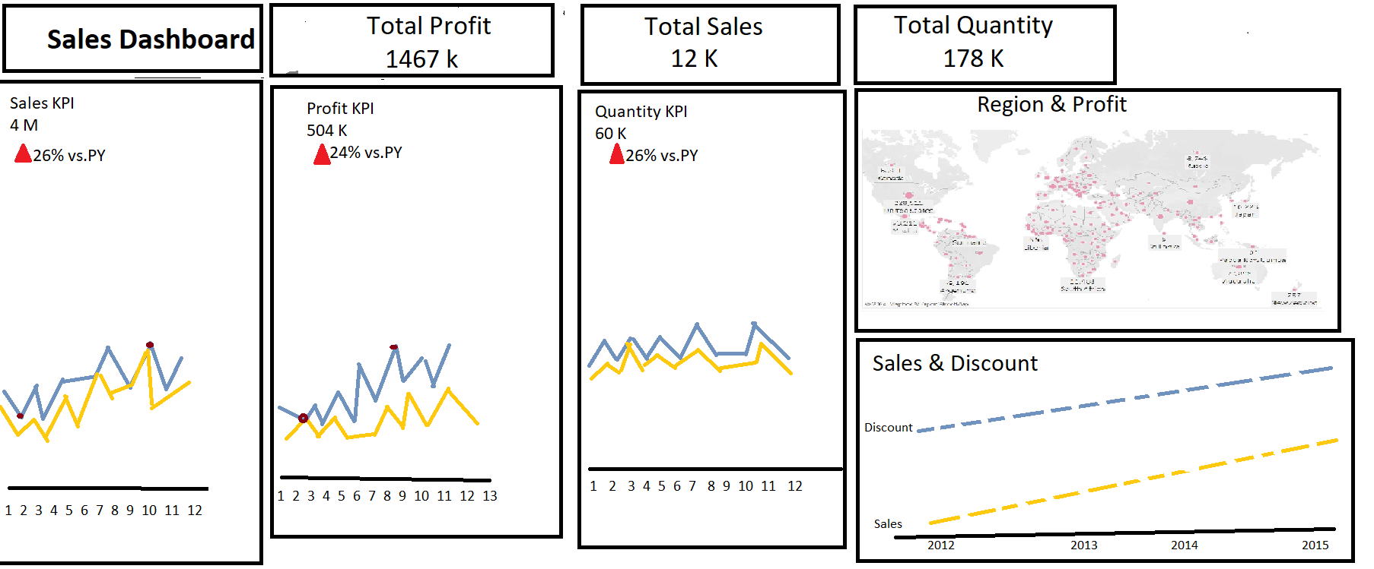
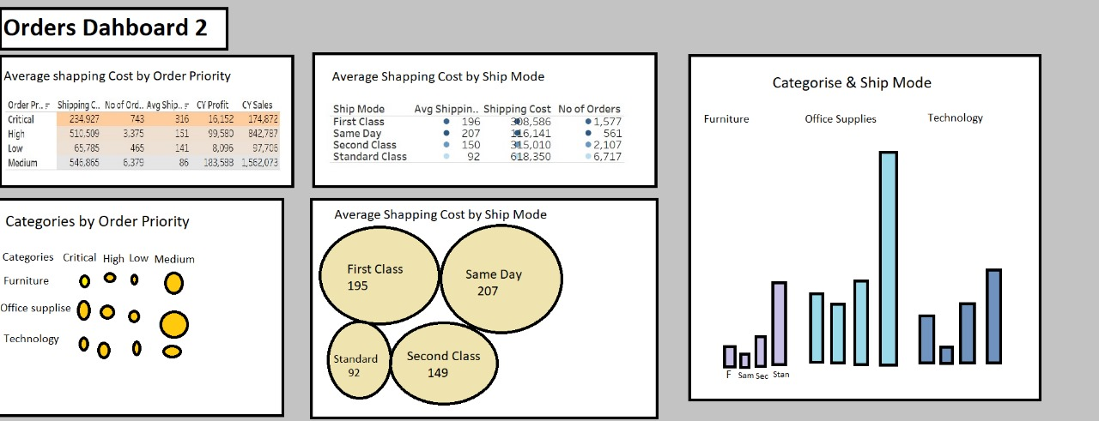
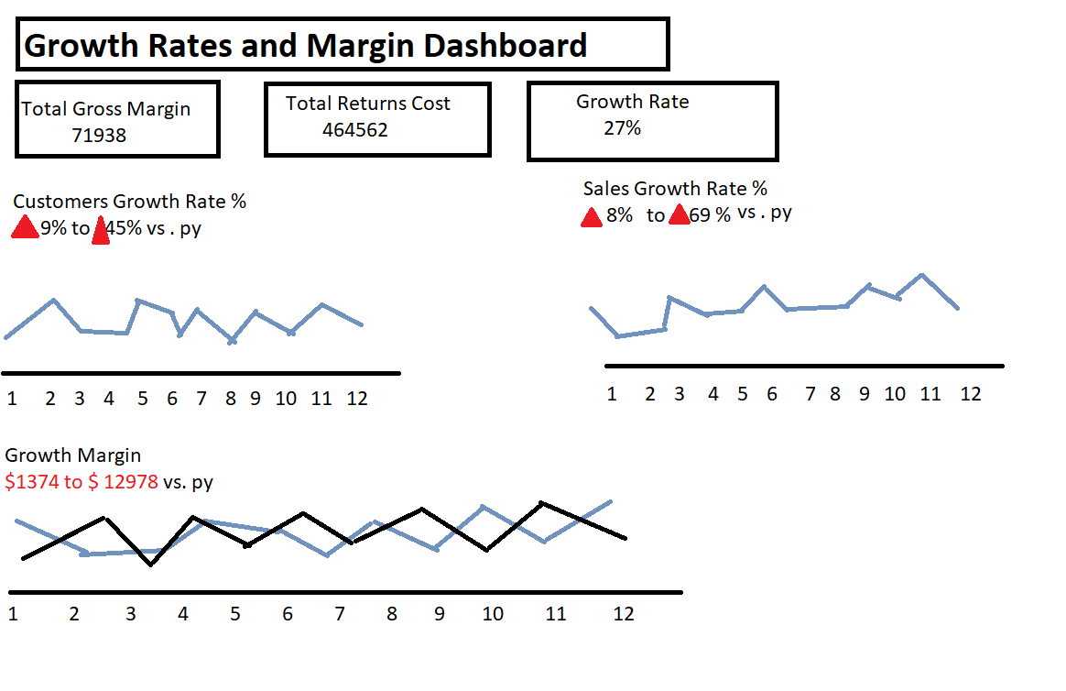
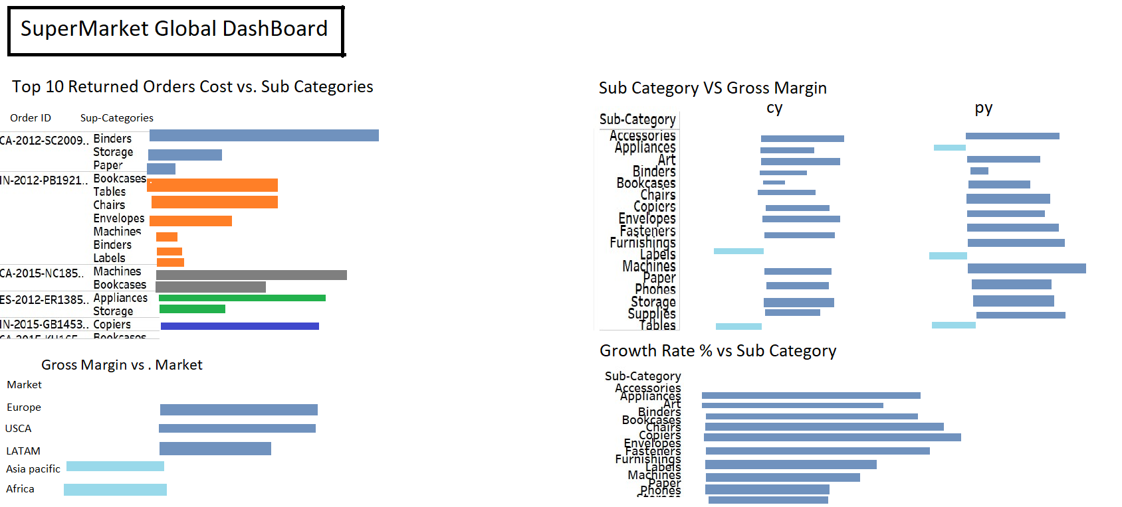
Blue Print

Slide 35
Dashboards
Customer Dashboard
Orders Dashboard
Shipping Dashboard
Sales Trend Dashboard
Products Dashboard
Growth Rates of Metrics & Gross Margin

Slide 36
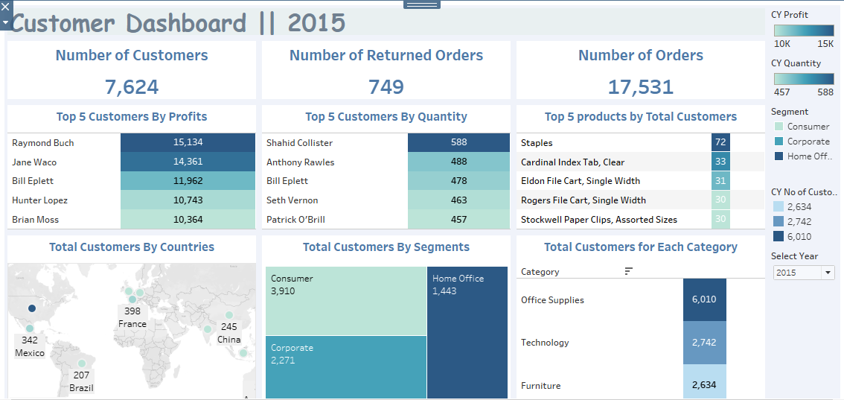
Customer Dashboard

Slide 37
Customer Dashboard
From the above cards, we can see that there were a total of 7,624 customers in 2015, placing 17,531 orders. Of those, 749 orders were returned.

Slide 38
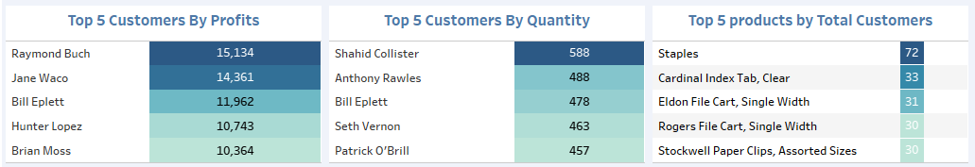
Customer Dashboard
This table shows the top 5 customers by profits, with Raymond Buch generating the highest profit at $15,134, followed by Jane Waco and Bill Eplett.
The next table lists the top 5 customers by quantity of orders. Shahid Collister tops this list with 588 orders, followed by Anthony Rawles with 488.
On the right, we can see the top 5 products by total number of customers. Staples was purchased by 72 customers, making it the most popular product in 2015.

Slide 39
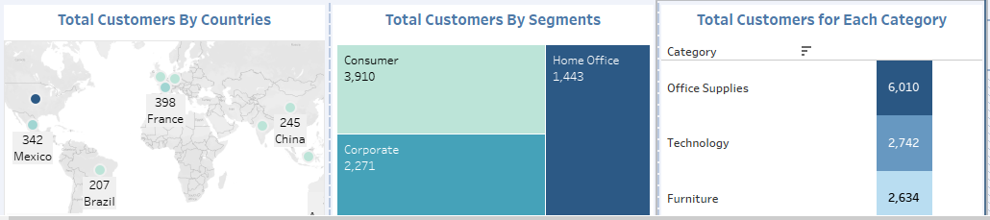
Customer Dashboard
This map illustrates the total customers by country, with United States having the highest number of customers at 1,303, followed by France with 398 and Australia with 381.
In this chart, customers are segmented into three categories: Consumer, Corporate, and Home Office.
The largest segment is Consumer, with 3,910 customers, followed by Corporate with 2,271, and Home Office with 1,443.
This final bar chart shows the total number of customers across three product categories: Office Supplies, Furniture, and Technology. Office Supplies had the highest number of customers at 6,010, followed by Technology and Furniture.

Slide 40
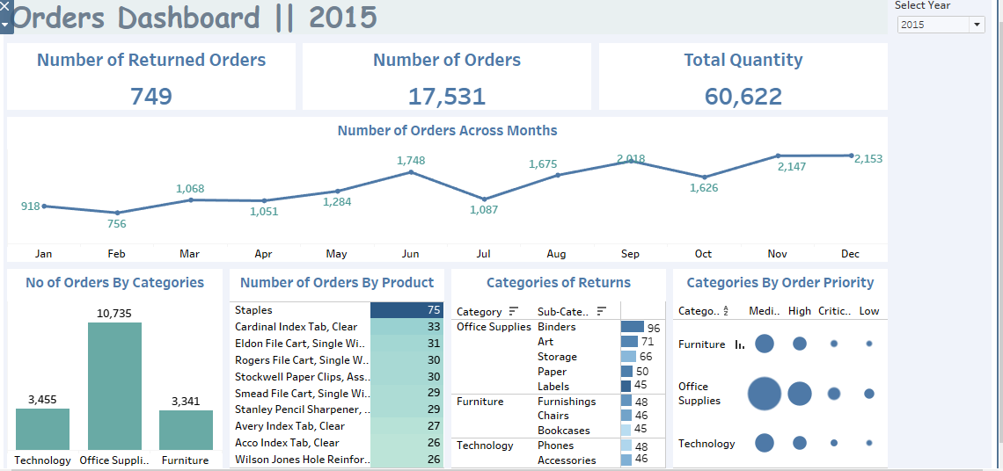
Orders Dashboard

Slide 41
Orders Dashboard
In 2015, we had a total of 749 returned orders. This reflects a small portion of the 17,531 total orders, suggesting that return rates were relatively low.
Customers ordered a total quantity of 60,622 items across all months, indicating a strong demand for our products throughout the year."

Slide 42
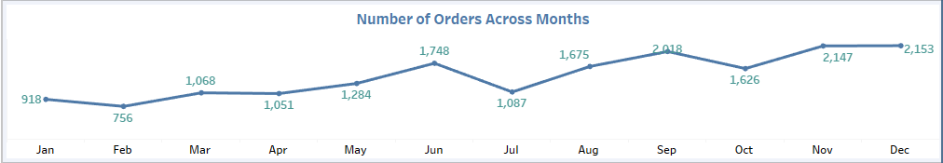
Orders Dashboard
This line chart shows the number of orders across each month in 2015. We can see that orders peaked in September with 2,018 orders and had the lowest point in February with only 756 orders.
Notice the steady increase in orders after May, which likely reflects increased seasonal demand, particularly leading up to the holiday season.

Slide 43
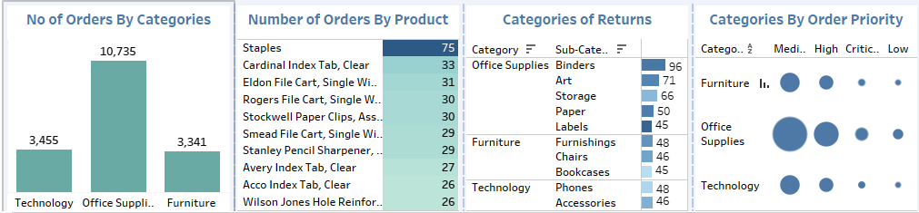
Orders Dashboard
Here, we can see the breakdown of orders by product categories. Office Supplies accounted for the highest number of orders with 10,735, followed by Technology with 3,455 and Furniture with 3,341.
This chart shows the top products by the number of orders. Staples were the most ordered product with 75 orders, followed by Cardinal Index Tab with 33 and Eldon File Cart with 30
This chart illustrates the product categories with the most returns. Office Supplies experienced the highest number of returns, particularly within the binders and storage sub-categories, indicating potential issues with product satisfaction or quality."
This bubble chart visualizes the distribution of orders based on their priority level. For Office Supplies, most of the orders were classified under medium and high priority, while Furniture saw a larger portion of critical priority orders.

Slide 44
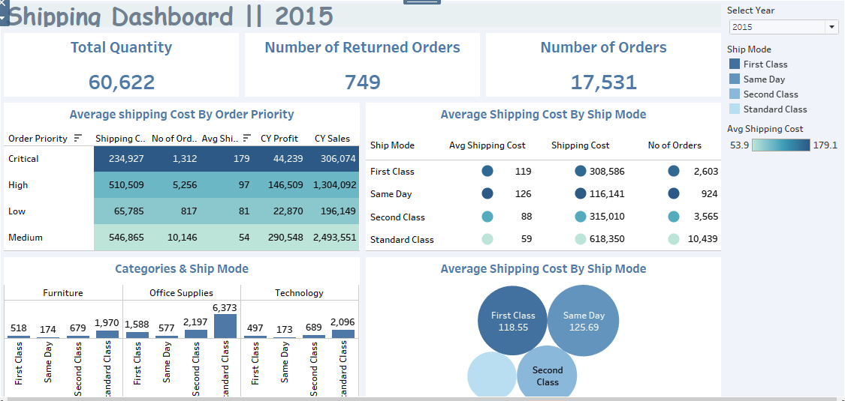
Shipping Dashboard

Slide 45
Shipping Dashboard
These Cards mention that the total quantity of orders is 60,622, and there were 749 returned orders, indicating overall order volume and customer satisfaction

Slide 46
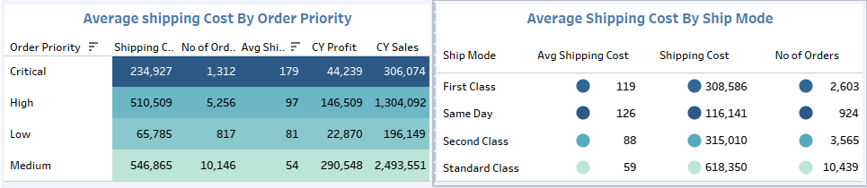
Shipping Dashboard
This Table explains the average shipping costs based on order priority (Critical, High, Low, Medium). For example, the average shipping cost for critical orders is $179, while for medium orders, it’s $54. This indicates that higher priority orders incur higher shipping costs.
This visualization displays the average shipping cost, total shipping cost, and number of orders based on the ship mode. From it we can find that Standard Class has the highest volume of orders (10,439) with the lowest average shipping cost. Same Day Shipping has the highest average cost but handles fewer orders.

Slide 47
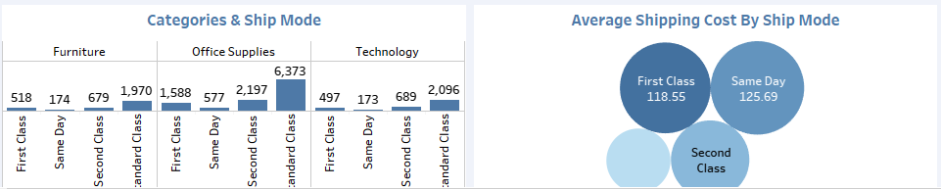
Shipping Dashboard
This section shows how shipping is distributed across product categories (Furniture, Office Supplies, and Technology) and ship modes:
Office Supplies: Has the highest total quantity (6,373).
Furniture: Most orders are Standard Class (1,970).
Technology: Shows a balanced distribution between ship modes, with 2,096 orders in total.
Same Day Shipping targets customers willing to pay more for faster delivery.

Slide 48
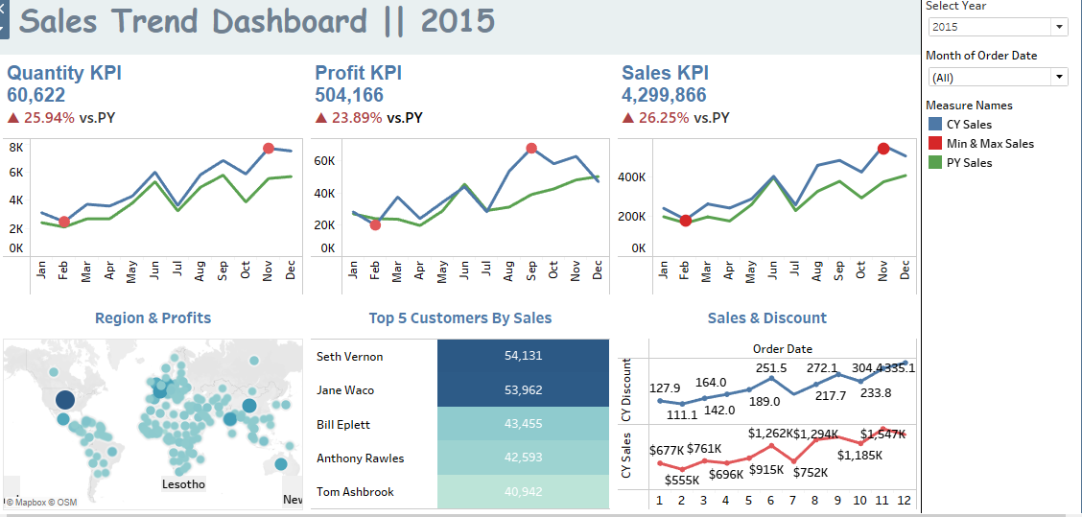
Sales Trend Dashboard

Slide 49
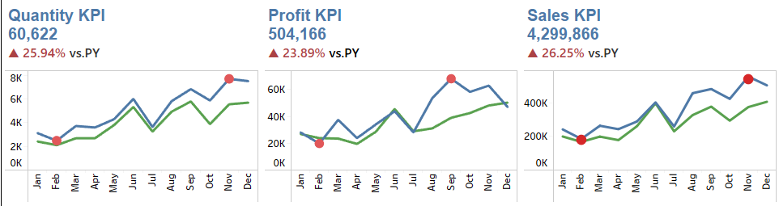
Sales Trend Dashboard
Total quantity sold is 60,622, reflecting a 25.94% increase compared to the previous year. This indicates strong demand and effective sales strategies.
Total profit stands at $504,166, with a growth of 23.89% year-over-year. This suggests improved operational efficiency and cost management alongside sales growth.
Total sales amount to $4,299,866, marking a 26.25% increase from the previous year. This growth indicates a robust sales performance across the year.

Slide 50
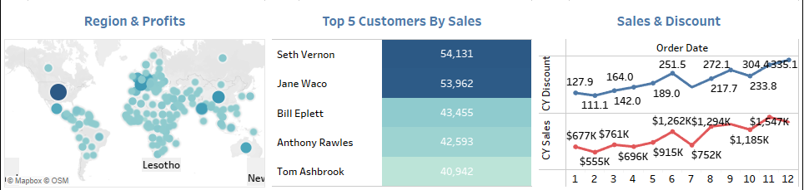
Sales Trend Dashboard
This map illustrates the total profits by country, with United States having the highest profits at 228,515$, followed by China with 107,732$ and France with 105,237$.
These customers represent significant contributions to total sales, suggesting targeted marketing efforts could enhance relationships with these key clients.
The sales trend shows consistent growth throughout the year, with noticeable peaks that may correspond with specific promotions or seasonal demand. The data indicates fluctuations in sales discounts, which should be analyzed to understand their impact on overall sales performance.

Slide 51
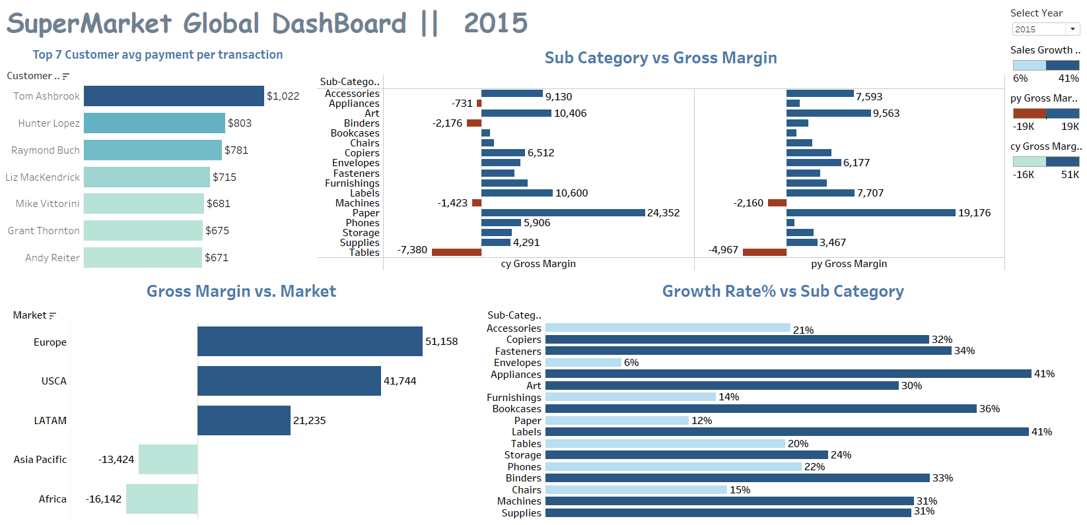
Product Dashboard

Slide 52
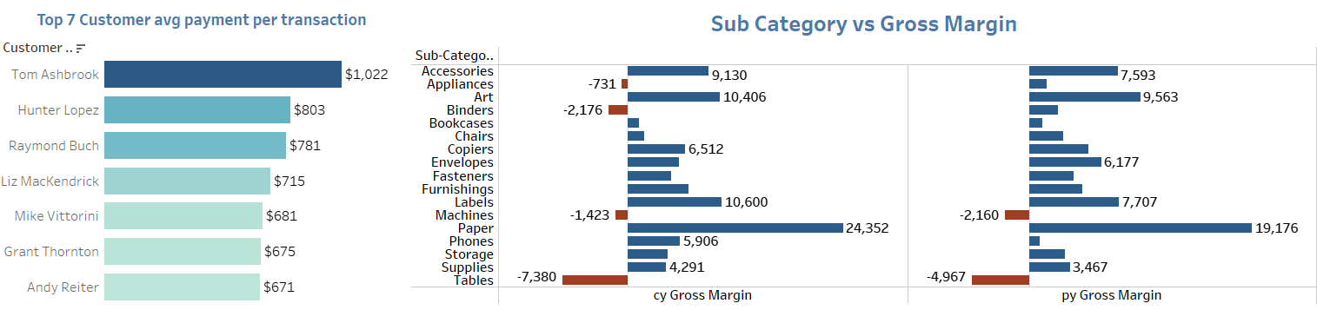
Product Dashboard
Tom Ashbrook leads with an average payment of $1,022, significantly higher than the others. This suggests he may be a key customer worth targeting for loyalty programs or exclusive offers.
The average payments of the other top customers range from $671 to $803, indicating a potential opportunity to increase engagement and sales with these customers.
The "Tables" subcategory shows the lowest gross margin at -7,380, indicating a need for strategic changes, such as price adjustments, cost reductions, or improved sales strategies.
Conversely, "Machines" has the highest gross margin of 24,352, suggesting it is a profitable area that could be further leveraged in marketing and inventory decisions.
The "Appliances" and "Art" subcategories have the highest growth rates at 41% and 34%, respectively. This indicates strong demand and potential for increased focus in these areas.
In contrast, "Fasteners" shows a growth rate of only 6%, suggesting it may be a stagnant category that requires re-evaluation.

Slide 53
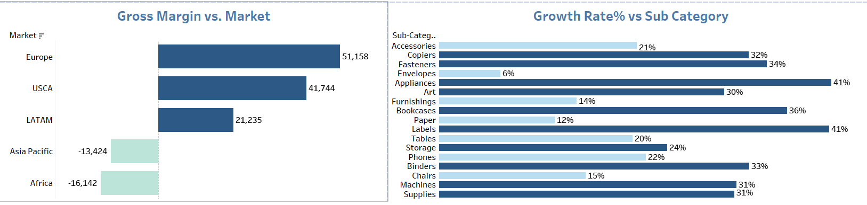
Product Dashboard
Europe has the highest gross margin at 51,158, followed by USCA at 41,744. These markets should be prioritized for expansion or increased marketing efforts.
The Asia Pacific and Africa regions report negative gross margins of -13,424 and -16,142, respectively, indicating significant challenges that need addressing, perhaps through market analysis or tailored strategies.
The "Appliances" and "Art" subcategories have the highest growth rates at 41% and 34%, respectively. This indicates strong demand and potential for increased focus in these areas.
In contrast, "Fasteners" shows a growth rate of only 6%, suggesting it may be a stagnant category that requires re-evaluation.

Slide 54
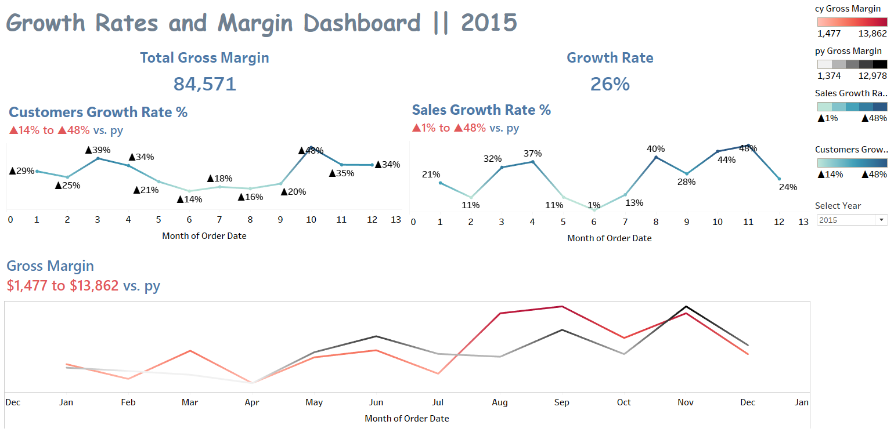
Growth Rates and Gross Margin Dashboard

Slide 55
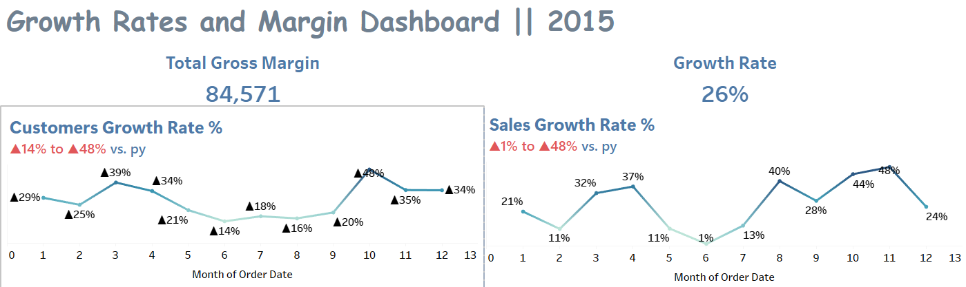
Growth Rates and Gross Margin Dashboard
The customer growth rate fluctuates throughout the year, with a peak of 48% in one month and a low of 14%. This variability suggests that certain months were particularly successful in attracting new customers.
Notably, the growth rate shows a positive trend, indicating effective customer acquisition strategies.
The sales growth rate also exhibits significant variability, peaking at 48% and dropping to 1% in some months.
The overall average growth rate is 26%, which is a strong indicator of sales performance throughout the year.

Slide 56
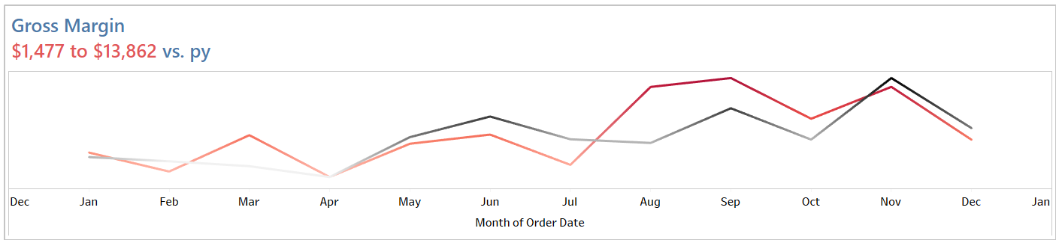
Growth Rates and Gross Margin Dashboard
The months of July and November appear particularly strong, with growth rates of 40% and 48%, respectively. These months may warrant further investigation to understand the drivers behind this success.
Conversely, the months of February and January show lower growth rates, suggesting potential areas for improvement in customer engagement or marketing efforts during those times.
Gross Margin Range:
1.The gross margin fluctuates between $1,477 and $13,862 compared to the previous year, indicating a wide range of profitability across different months.
2.This suggests that while some months are highly profitable, others may struggle, highlighting the need for consistent performance across all months.

Slide 57
Recommendations for Stakeholders
Address Return Issues: Investigate the causes of the 749 returned orders to improve product quality and customer satisfaction.
Optimize Shipping Costs: Focus on reducing shipping costs, particularly for high-volume categories like Office Supplies and Technology, while maintaining service levels for critical orders.
Enhance Fulfillment for Critical Orders: Prioritize the fulfillment process for critical orders to maximize customer satisfaction and profit margins.
Evaluate Shipping Modes: Assess the effectiveness of different shipping modes, especially for Same Day and Second Class, to ensure timely deliveries and cost efficiency.
Leverage Sales Insights: Use insights from shipping costs and sales data to refine pricing strategies and enhance customer offerings, ensuring alignment with consumer expectations.

Slide 58




DO YOU HAVE ANY QUESTIONS?

